Slide 1

Hotel Reservation Analysis (Data Analysis using SQL)
Submitted By:
OM Prakash Sahoo
E Mail Id : omprakashsahoo280@gmail.com
Internship Details:
Mentorness Internship Program, Batch MIP-DA-10

Slide 2
Introduction :
This project involves analyzing a hotel reservation dataset using SQL. The primary objectives are to gain insights into reservation patterns, identify popular choices among guests, and understand various trends in the data.

Slide 3
Dataset overview :
The dataset contains information about hotel reservations, including:
- Number of adults and children
- Number of weekend and weeknights
- Type of meal plan
- Room type reserved
- Lead time
- Arrival date
- Market segment type
- Average price per room
- Booking status

Slide 4
Objectives :
- Determine the total number of reservations.
- Identify the most popular meal plan.
- Calculate the average price per room for reservations involving children.
- Analyze the number of reservations for a specific year (e.g., 2018).
- Find the most commonly booked room type.
- Determine the number of reservations that fall on a weekend.
- Identify the highest and lowest lead time for reservations.
- Find the most common market segment type for reservations.
- Count the number of confirmed reservations.
- Calculate the total number of adults and children across all reservations.
- Determine the average number of weekend nights for reservations involving children.
- Analyze the number of reservations made in each month.
- Calculate the average number of nights spent by guests for each room type.
- Identify the most common room type and average price for reservations involving children.
- Determine the market segment type with the highest average price per room.

Slide 5
Methodology :
- Used PostgreSQL to create and manage the database.
- Imported the dataset into PostgreSQL.
- Wrote SQL queries to extract insights from the data.
- Analyzed the results to answer the key questions.

Slide 6

1. What is the total number of reservations in the dataset?
SQL Query :
SELECT COUNT(*) AS total_reservations FROM reservations;
Output →

Slide 7

2. Which meal plan is the most popular among guests?
SQL Query :
SELECT type_of_meal_plan, COUNT(*) AS count
FROM reservations
GROUP BY type_of_meal_plan
ORDER BY count DESC
LIMIT 1;
Output →

Slide 8

3. What is the average price per room for reservations involving children?
SQL Query :
SELECT AVG(avg_price_per_room) AS avg_price
FROM reservations
WHERE no_of_children > 0;
Output →

Slide 9

4. How many reservations were made for the year 20XX (replace XX with the desired year)?
SQL Query :
SELECT COUNT(*) AS reservations_2022
FROM reservations
WHERE EXTRACT(YEAR FROM arrival_date) = 2022;
Output →

Slide 10

5. What is the most commonly booked room type?
SQL Query :
SELECT room_type_reserved, COUNT(*) AS count
FROM reservations
GROUP BY room_type_reserved
ORDER BY count DESC
LIMIT 1;
Output →

Slide 11

6. How many reservations fall on a weekend (no_of_weekend_nights > 0)?
SQL Query :
SELECT COUNT(*) AS weekend_reservations
FROM reservations
WHERE no_of_weekend_nights > 0;
Output →

Slide 12

7. What is the highest and lowest lead time for reservations?
SQL Query :
SELECT MAX(lead_time) AS highest_lead_time, MIN(lead_time) AS lowest_lead_time
FROM reservations;
Output →

Slide 13

8. What is the most common market segment type for reservations?
SQL Query :
SELECT market_segment_type, COUNT(*) AS count
FROM reservations
GROUP BY market_segment_type
ORDER BY count DESC
LIMIT 1;
Output →

Slide 14

9. How many reservations have a booking status of "Confirmed"?
SQL Query :
SELECT COUNT(*) AS confirmed_reservations
FROM reservations
WHERE booking_status = 'Confirmed';
Output →

Slide 15

10. What is the total number of adults and children across all reservations?
SQL Query :
SELECT SUM(no_of_adults) AS total_adults, SUM(no_of_children) AS total_children
FROM reservations;
Output →

Slide 16

11. What is the average number of weekend nights for reservations involving children?
SQL Query :
SELECT AVG(no_of_weekend_nights) AS avg_weekend_nights
FROM reservations
WHERE no_of_children > 0;
Output →

Slide 17
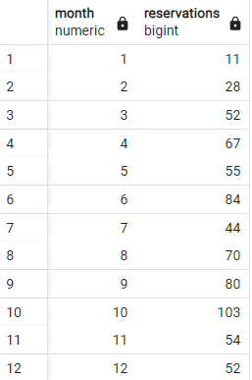
12. How many reservations were made in each month of the year?
SQL Query :
SELECT EXTRACT(MONTH FROM arrival_date) AS month, COUNT(*) AS reservations
FROM reservations
GROUP BY month
ORDER BY month;
Output →

Slide 18
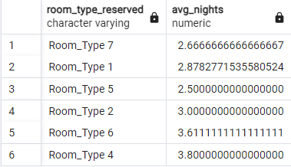
13. What is the average number of nights (both weekend and weekday) spent by guests for each room type?
SQL Query :
SELECT room_type_reserved,
AVG(no_of_weekend_nights + no_of_week_nights) AS avg_nights
FROM reservations
GROUP BY room_type_reserved;
Output →

Slide 19

14. For reservations involving children, what is the most common room type, and what is the average price for that room type?
SQL Query :
SELECT room_type_reserved, COUNT(*) AS count, AVG(avg_price_per_room) AS avg_price
FROM reservations
WHERE no_of_children > 0
GROUP BY room_type_reserved
ORDER BY count DESC
LIMIT 1;
Output →

Slide 20

15. Find the market segment type that generates the highest average price per room.
SQL Query :
SELECT market_segment_type, AVG(avg_price_per_room) AS avg_price
FROM reservations
GROUP BY market_segment_type
ORDER BY avg_price DESC
LIMIT 1;
Output →

Slide 21
Conclusion :
- The analysis provided insights into guest preferences and booking trends.
- The most popular meal plan was identified.
- The average price per room for different types of reservations was calculated.
- Seasonal trends in reservations were observed.

Slide 22
Thank
You

